Slide 1
KNN and Naïve Bayes Algorithm
Supervised Learning Classification

Slide 2
Agenda
Basic Concepts
Probability
Bayes theorem
Naïve Bayes Algorithm
Business Problem
Laplace smoothing method

Slide 3
Naïve Bayes

Slide 4
Business problem: label the email as spam or ham
It can be helpful if an algorithm can label received emails as important (ham) emails or junk (spam) emails for a user.
Such a model can ease the effort of the user by directly showing them important emails and filter out the junk.

Slide 5
Visiting Basics

Slide 6

Probability
Probability is how likely an event is to occur
The probability of an event always lies in between 0 and 1
0 indicates impossibility of the event and 1 indicates a certain event

Slide 7
Probability
Question:
There are 40 candidates in a team with equal calibre. Out of which 25 are men and 15 are women. A person is randomly chosen to be the team leader. What is the probability that the person is a woman?

Slide 8
Probability
Solution:
Number of ways event can occur: 15
Total number of outcomes: 40
Therefore the probability: 15/40 = 0.375

Slide 9
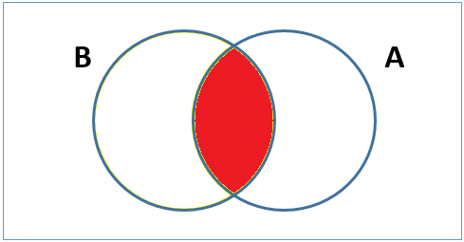
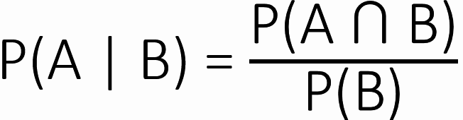
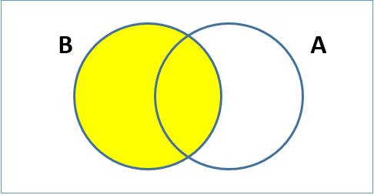
Conditional probability
The conditional probability of an event A given B is the probability that the event A will occur given that an event B has already occurred
Denoted by P(A|B)

Slide 10
Conditional probability
Question:
A pair of fair dice is rolled. If the sum of numbers that appear is 6, find the probability that one of the dice shows 2?

Slide 11
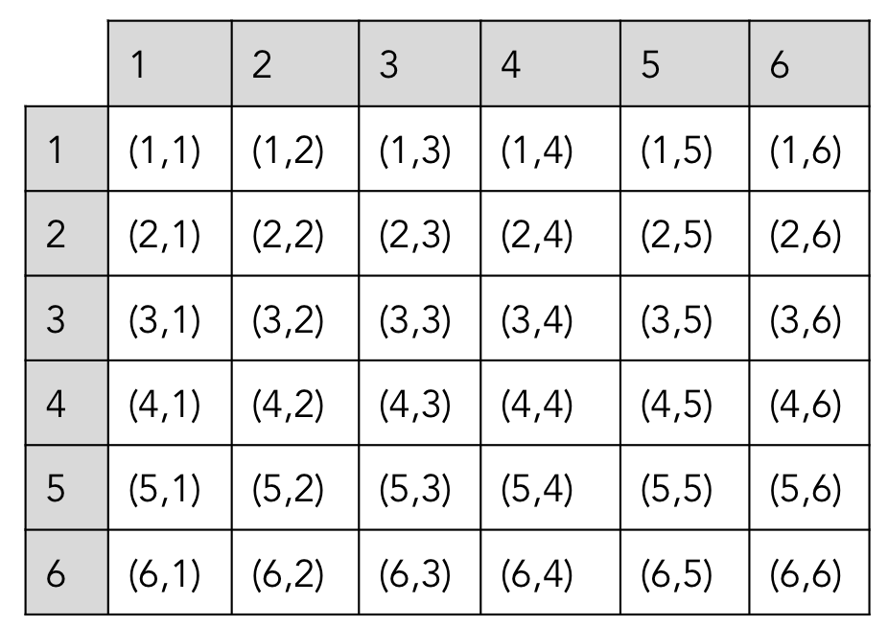
Conditional probability
First Dice
Solution:
Let A: the event of getting the sum as 6
The ways A can occur: {(1,5), (2,4), (3,3), (4,2), (5,1)}
Let B: the event that number 2 appears on the dice
The ways B can occur: {(1,2), (2,1), (2,2), (2,3), (2,4), (2,5), (2,6), (3,2), (4,2), (5,2), (6,2)}
Thus, the event that sum of the die is 6 and number 2 appears on the dice is A ∩ B.
A ∩ B = {(2,4), (4,2)}
The total number of samples is 36.
Second Dice

Slide 12
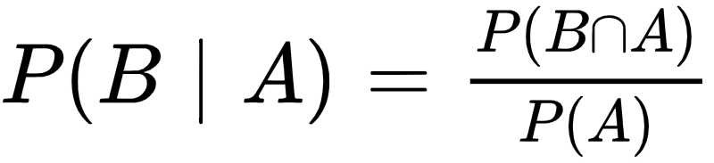
Conditional probability
Solution:
The required probability is

Slide 13
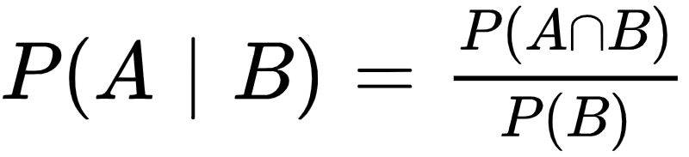
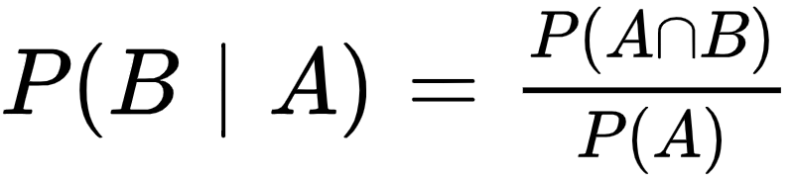
Multiplication theorem
Thus,

Slide 14
Bayes theorem
Conditional probability is the likelihood of an event given that another event has occurred
Bayes theorem provides a way to update the probability based on the new information
It is completely based on the conditional probability
Known as Bayes’ Rule or Bayes law

Slide 15
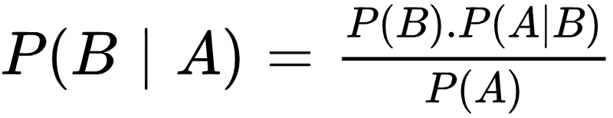
Bayes theorem - formula
Where, A and B are events
P(A | B) the likelihood of event A occurring given that B is true
P(B | A) the likelihood of event B occurring given that A true
P(A), P(B): The independent probabilities of A and B

Slide 16
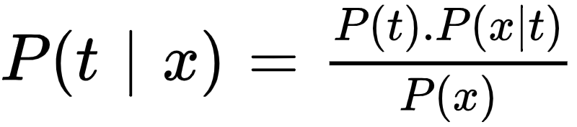
Bayes theorem - formula
For the naïve bayes classification the formula is as
probability of the class label, it is the prior probability
conditional probability of t given that the predictor x, i.e. posterior probability
conditional probability of x given that its class label is t, i.e. likelihood
probability of the value taken by the predictor variable, i.e. evidence

Slide 17
Posterior Probability
In context with a classification problem, the posterior probability is the conditional probability of a class label taking value t given that the predictor takes value x
Example:
Consider the example of labelling an email as spam or ham. The conditional probability that it is a spam message given the word appears in it, i.e. P(spam | word) is the posterior probability

Slide 18
Prior probability
Prior probability is the probability of an event computed from the data at hand
Example:
Consider the example of labelling an email as spam or ham. The probability the email is spam, i.e. P(spam) is the prior probability Likewise P(ham) is also a prior probability

Slide 19
Likelihood
In context with a classification problem, the Likelihood is the conditional probability of a predictor taking value x given that its class label is t
Example:
Consider the example of labelling an email as spam or ham. The conditional probability that the word appears in a spam, i.e. P(word | spam) is the likelihood

Slide 20
Evidence
It is the probability that the predictor takes value x
Also known as marginal probability
Example:
Consider the example of labelling an email as spam or ham. The probability that the word appears in a message, i.e. P(word) is the evidence

Slide 21
Naïve bayes classification
A naïve bayes classifier uses the Bayes’ theorem for classification
It is an eager learning algorithm. Since it does not wait for test data to learn, it can classify the new instance faster

Slide 22
Assumptions
Assumption 1: The predictors are independent of each other.
Example:
Consider the example of labelling an email as spam or ham. The probability of the word Good appearing in the email is independent of the Money.
Thus P(Good ∩ Money) = P(Good) . P(Money) … since events are independent

Slide 23
Assumptions
Assumption 2: All the predictors have an equal effect on the outcome.
Example:
Consider the example of labelling an email as spam or ham. The appearance of a particular word in the email does not have more importance in deciding whether it is a spam or ham
Eg: The word Friendship does not have more importance to say whether it’s a spam/ham email.

Slide 24

Bayes theorem - classification problem
We have the Bayes theorem as
For X=(x₁, x₂, …, x_{n}), applying the chain rule, we have
Since the denominator does not change for the values taken by the predictor as assumed in the second assumption. The denominator can be removed.

Slide 25
Bayes theorem - classification problem
We get
For convenience, write it as

Slide 26
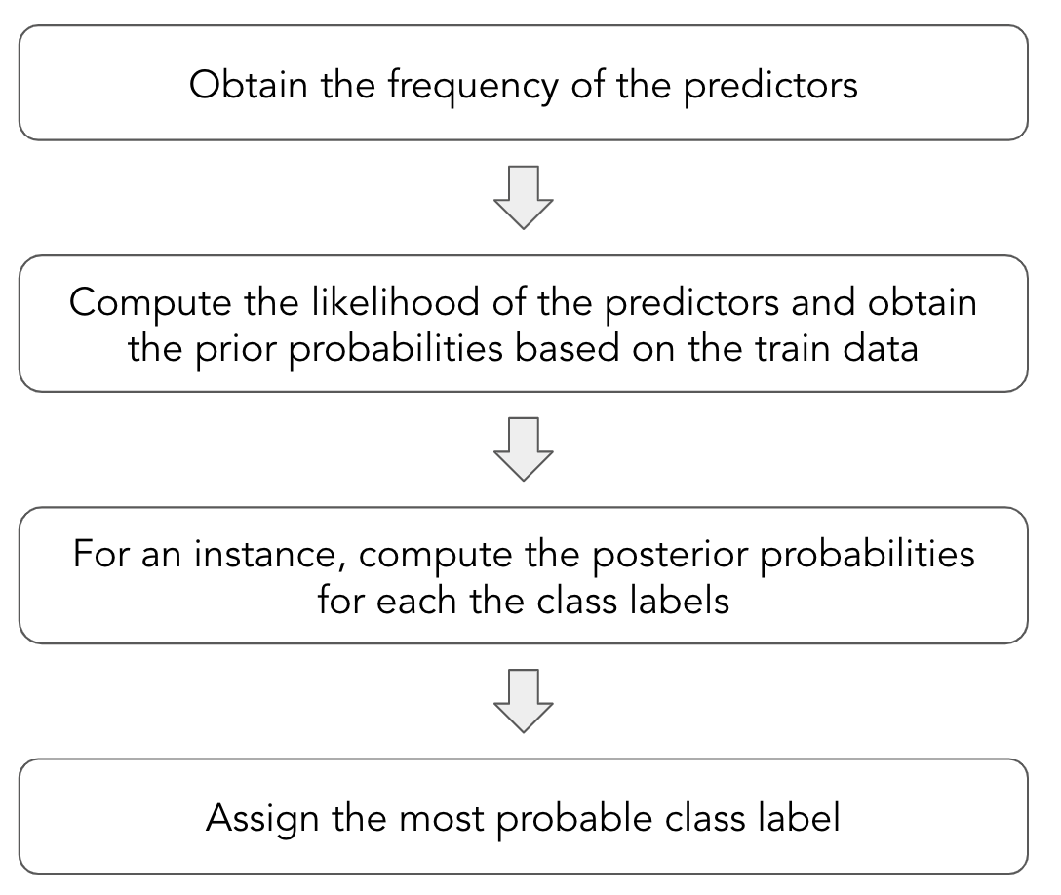
Naïve Bayes: Procedure

Slide 27
Business problem: label the email as spam or ham
We shall consider the problem of labelling the received emails as spam or ham
Choose a few words you find in emails
Work
Snacks
Good
Lonely
Money
Horoscope

Slide 28
Spam-ham example
1
Consider the frequency of these words used in spam and ham emails as shown below
 | Spam | Ham
Good | 2 | 10
Lonely | 2 | 1
Horoscope | 20 | 5
Work | 5 | 12
Snacks | 0 | 5
Money | 21 | 7

Slide 29
Spam-ham example
2
 | Spam | Ham
Good | 2 | 10
Lonely | 2 | 1
Horoscope | 20 | 5
Work | 5 | 12
Snacks | 0 | 5
Money | 21 | 7
Total | 50 | 40
 | Spam | Ham
Good | 2/50 = 0.04 | 10/40 = 0.25
Lonely | 2/50 = 0.04 | 1/40 = 0.025
Horoscope | 20/50 = 0.4 | 5/40 = 0.125
Work | 5/50 = 0.1 | 12/40 = 0.30
Snacks | 0/50 = 0 | 5/40 = 0.125
Money | 21/50 = 0.42 | 7/40 = 0.175
Obtain the likelihoods

Slide 30
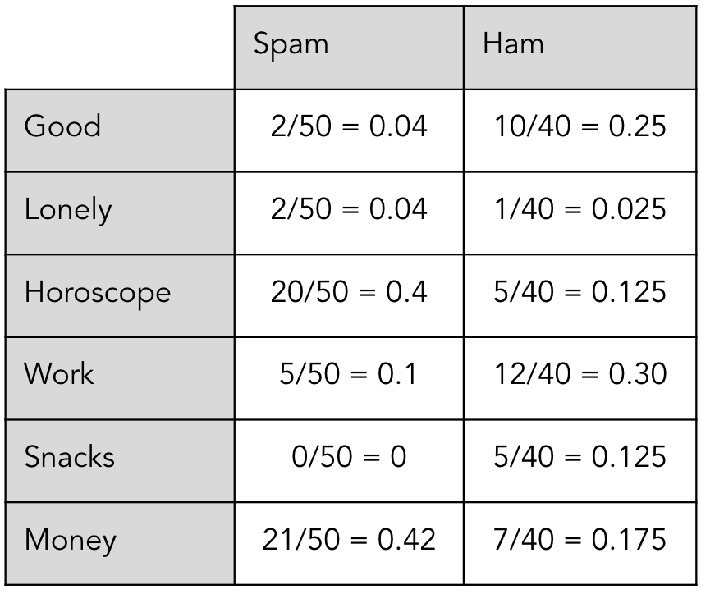
Likelihood
The probability that the word Good appears in a spam email, ie P(Good | Ham) is 0.25.
This is the Likelihood.

Slide 31
Spam-ham example
3
Obtain the prior probability
From the data we have 15% of the emails are spam and the remaining are ham
Thus the prior probabilities are
P(Spam) = 0.15 and P(Ham) = 0.85

Slide 32
Spam-ham example
4
Consider the word sequence Good Work, does it belong to a spam message?
Our instance is Good Work.
For our instance, compute the posterior probabilities for each the class labels - spam or ham

Slide 33
Spam-ham example
4
Compute the posterior probabilities for each the class labels - Spam or Ham
For Spam,
P(Spam| Good, Work) = P(Spam) . P(Good | Spam). P(Work | Spam) = (0.15) . (0.04) . (0.1) = 0.0006
For Ham,
P(Ham| Good, Work) = P(Ham) . P(Good | Ham). P (Work | Ham) = (0.85) . (0.25) . (0.30) = 0.063

Slide 34
Spam-ham example
5
Assign the most probable class label
For Spam,
P(Spam| Good, Work) = 0.0006
For Ham,
P(Ham| Good, Work) = 0.063
Since 0.063 > 0.0006, we assign the class label as Ham to the instance Good Work.

Slide 35
For Spam,
P(Spam| Good, Work) = 0.0006
For Ham,
P(Ham| Good, Work) = 0.063
The sum is 1

Slide 36
Obtain the class label
Question:
With help of the previous data. Label the email containing word Horoscope 1 time, Money 2 times and Snack 1 time
The prior probabilities are:

Slide 37
Obtain the class label
Solution:
For Ham,
P(Ham| Horoscope, Money, Money, Snack)
= P(Ham) . P (Horoscope | Ham) . P(Money | Ham). P(Money | Ham) . P(Snack | Ham)
= (0.85) . (0.125) . (0.175) . (0.175) . (0.125)
= 0.0004

Slide 38
Obtain the class label
Solution:
For Spam,
P(Spam| Horoscope, Money, Money, Snack)
= P(Spam) . P (Horoscope | Spam) . P(Money | Spam). P(Money | Spam) . P(Snack | Spam)
= (0.15) . (0.4) . (0.42) . (0.42) . (0.00)
= 0.0
… Here is a problem

Slide 39
Obtain the class label
Solution:
For Spam,
P(Spam| Horoscope, Money, Money, Snack)
= P(Spam) . P (Horoscope | Spam) . P(Money | Spam). P(Money | Spam) . P(Snack | Spam)
= (0.15) . (0.4) . (0.42) . (0.42) . (0.00)
= 0.000
… No matter which other word(s) is seen along with Snack, the email will never be classified as Spam. Since the frequency for Snack is 0.

Slide 40
Laplace smoothing method
To solve the zero probability problem, we use the Laplace smoothing method
Add α to every count so; the count is never zero
α > 0. Generally, α = 1
Consider the α for the divisor as well

Slide 41
Obtain the class label
Solution:
 | Spam | Ham
Good | 2 | 10
Lonely | 2 | 1
Horoscope | 20 | 5
Work | 5 | 12
Snacks | 0 | 5
Money | 21 | 7
Total | 50 | 40
 | Spam | Ham
Good | 3 | 11
Lonely | 3 | 2
Horoscope | 21 | 6
Work | 6 | 13
Snacks | 1 | 6
Money | 22 | 8
Total | 56 | 46
Add α = 1, to each count

Slide 42
Obtain the class label
Solution:
 | Spam | Ham
Good | 3 | 11
Lonely | 3 | 2
Horoscope | 21 | 6
Work | 6 | 13
Snacks | 1 | 6
Money | 22 | 8
Total | 56 | 46
 | Spam | Ham
Good | 3/56 = 0.05 | 11/46 = 0.24
Lonely | 3/56 = 0.05 | 2/46 = 0.04
Horoscope | 21/56 = 0.37 | 6/46 = 0.13
Work | 6/56 = 0.11 | 13/46 = 0.28
Snacks | 1/56 = 0.02 | 6/46 = 0.13
Money | 22/56= 0.40 | 8/46 = 0.18
Obtain the new likelihoods

Slide 43
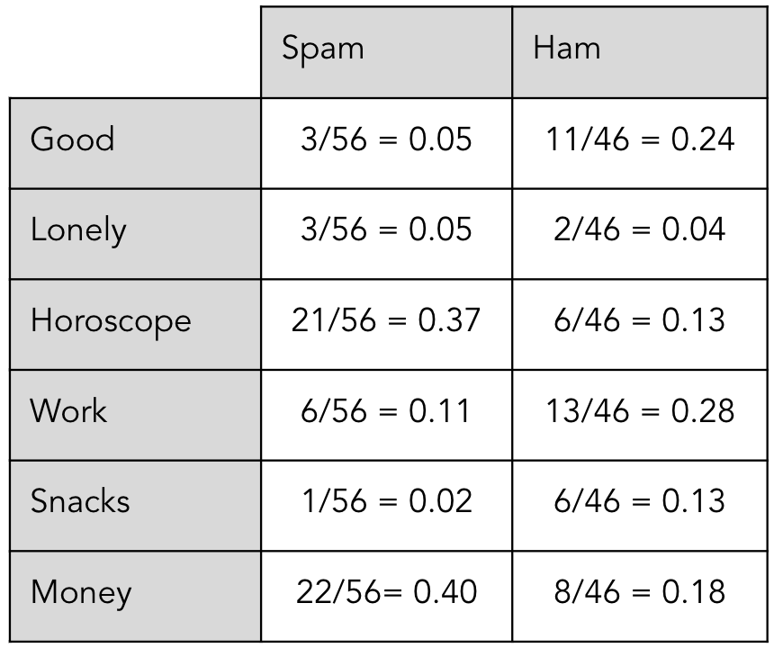
Obtain the class label
Solution:
For Ham,
P(Ham| Horoscope, Money, Money, Snack)
= P(Ham) . P (Horoscope | Ham) . P(Money | Ham). P(Money | Ham) . P(Snack | Ham)
= (0.85) . (0.13) . (0.18) . (0.18) . (0.13)
= 0.0004

Slide 44
Obtain the class label
Solution:
For Spam,
P(Spam| Horoscope, Money, Money, Snack)
= P(Spam) . P (Horoscope | Spam) . P(Money | Spam). P(Money | Spam) . P(Snack | Spam)
= (0.15) . (0.37) . (0.4) . (0.4) . (0.02)
= 0.0017
… The problem is solved using the Laplace smoothing method

Slide 45
Obtain the class label
Assign the most probable class label
For Spam,
P(Spam| Horoscope, Money, Money, Snack) = 0.0017
For Ham,
P(Ham| Horoscope, Money, Money, Snack) = 0.0004
Since 0.0017 > 0.0004, we assign the class label as Spam to the instance Horoscope, Money, Money, Snack.

Slide 46
Naïve Bayes Classifier available in the scikit learn library
Gaussian Naïve Bayes:
It is used when predictors are continuous
Assumes that the predictors follow normal distribution
The Gaussian Naïve Bayes Classifier used the normal distribution for classification
Multinomial Naïve Bayes
Used for document classification problem - classify whether a document is a sport, history, or science article
The predictors are the frequency of the words present in the article
Bernoulli Naïve Bayes
This is similar to the multinomial naive bayes, but the predictors are binary valued (boolean)

Slide 47
Applications of Naïve Bayes
Spam Filtering
Sentiment Analysis
Recommendation System

Slide 48
Naïve Bayes: advantages
Easy to implement in the case of text analytics problems
Used for multiple class prediction problems
Performs better for categorical data than numeric data

Slide 49
Naïve Bayes: disadvantages
Fails to find relationship among features
May not perform when the data has more number of predictor
The assumption of independence among features may not always hold good

Slide 50
Thank You

